Slide 1
Getting started with Classification

Slide 2
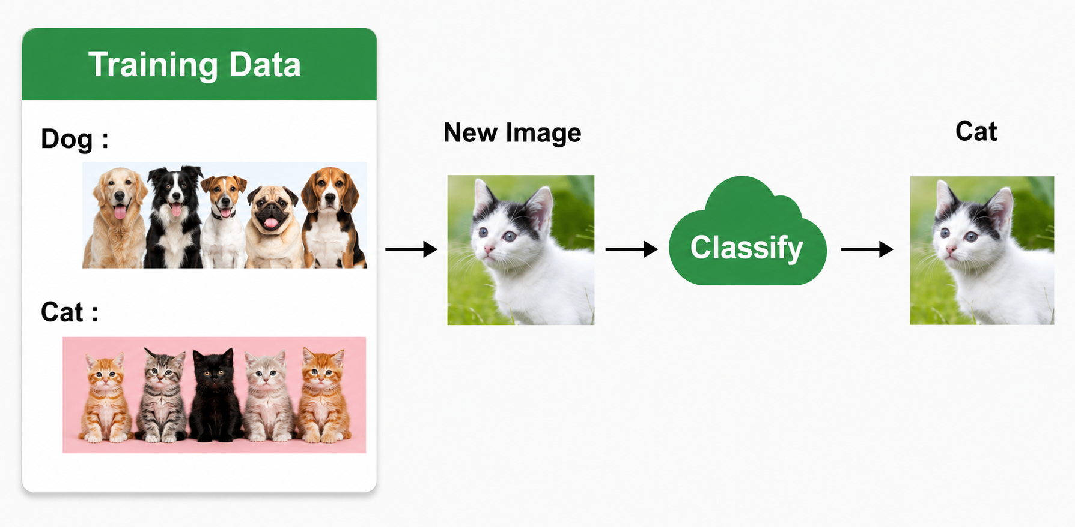
Classification is a supervised machine learning method used to predict classes or categories from input data. It places each data point into a predefined class by learning patterns from the training data.
Predicts categories: Identifies the class of new data points.
Uses labeled data: It is trained on datasets where the correct class labels are already available.
Common examples: Spam vs. non-spam emails, diseased vs. healthy patients.
For example, a classification model can be trained using a dataset of images labeled as dogs or cats. It can then classify new, unseen images as either dogs or cats by analyzing features such as color, texture, or shape.

Slide 3
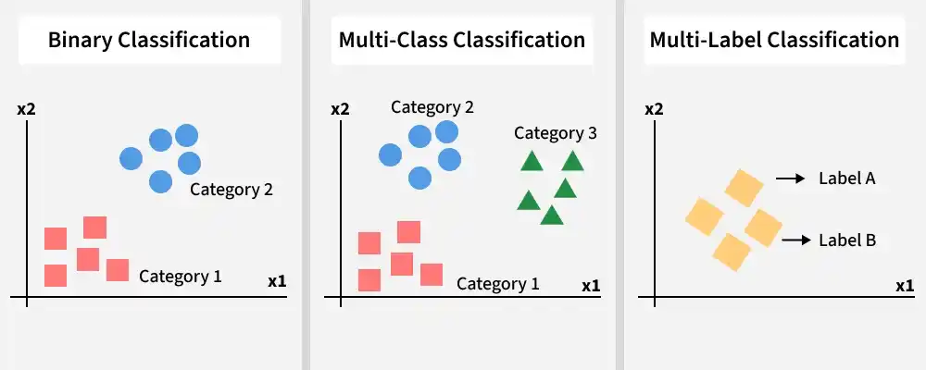
Types of Classification
Classification in machine learning is the process of grouping data into different categories based on its features or characteristics. The type of classification problem is determined by the number of classes and the way the categories are organized.

Slide 4
1. Binary Classification
Binary classification is the most basic type of classification in which data is categorized into one of two possible classes. The model examines the input features and predicts which of the two categories the data belongs to. Some key aspects of binary classification are:
Only two classes: Each data point belongs to one of two categories.
Common examples: Spam vs. not spam emails, diseased vs. healthy patients.
Feature-based decision: The model uses the input features to identify the correct class.
2. Multiclass Classification
Multiclass classification is used when data must be classified into more than two categories. The model evaluates the input features and predicts the single class that best fits the data. Some key aspects of multiclass classification are:
More than two classes: Each data point is assigned to one of several categories.
One final prediction: The model chooses only one class for each input.
Common examples: Image classification, such as identifying a cat, dog, or bird.
3. Multi-Label Classification
Multi-label classification enables a single data point to be assigned to multiple categories at the same time. Unlike multiclass classification, where only one class is selected, this method allows the model to predict several labels for the same input. Key aspects include:
Multiple labels for one data point: A single input can belong to more than one category.
Overlapping labels: The categories are not mutually exclusive.
Common example: A movie recommendation system may label a movie as both action and comedy based on features such as the plot, actors, or genre tags.

Slide 5
Working
Classification works by training a model using labeled data so that it can recognize patterns and predict the correct class for new inputs. The main steps are:
Data Collection: Begin with a dataset in which every data point has a known label.
Feature Extraction: Select important features such as color, shape, or texture that help separate different classes.
Model Training: The algorithm learns the relationship between the features and the correct class labels.
Model Evaluation: The trained model is tested on unseen data to evaluate its accuracy.
Prediction: The model assigns a class to new data based on the patterns it has learned.
Model Improvement: If the results are not satisfactory, the model or its parameters are modified and trained again.
Classification Algorithms
To build a classification model, it is necessary to understand the algorithms used for classification. One of the most widely used algorithms is Logistic Regression. Classification algorithms can be divided into different categories, such as:
1. Linear Classifiers
Linear classifiers are models that separate classes by creating a linear decision boundary. They are simple to use and computationally efficient. Some commonly used linear classification models are:
Logistic Regression
Support Vector Machines

Slide 6
2. Non-Linear Classifiers
Non-linear classifiers create non-linear decision boundaries to distinguish between different classes. They are capable of learning more complex relationships between input features and the target variable. Some commonly used non-linear classification models are:
K-Nearest Neighbours
Kernel SVM
Decision Tree Classification
Random Forests
Applications
Email Spam Filtering: Identifies whether an email is spam or not spam based on its content.
Credit Risk Assessment: Predicts if a loan applicant is likely to default using factors such as credit score and income.
Medical Diagnosis: Determines whether a patient has diseases like cancer or diabetes using medical information.
Image Classification: Applied in areas such as facial recognition, self-driving vehicles, and medical imaging.
Sentiment Analysis: Classifies text as positive, negative, or neutral based on its sentiment.
Fraud Detection: Detects suspicious transaction patterns to identify financial fraud.
Recommendation Systems: Although not purely a classification task, they often rely on ranking or similarity-based techniques.

